Slide 1


IPMV Review (Semester VI)
Vivekanand Education Society’s Institute of Technology
Electronics and Telecommunication Engineering
Title of Project: Creating Simulink based simulation for at least 4 Currency Notes Detection
Name of Professor : Mr. Mrugendra Vasmatkar
Designation : Assistant Professor (EXTC)
Team members:
Rishika Chaubal - 10 (D14B)
Renu Dharamkar - 17 (D14B)
Hritika Mulay - 35 (D14B)
Aman Yadav - 66 (D14B)

Slide 2
Contents to be covered
Problem Statement
Proposed Solution
Complete Flow chart of Proposed System
Algorithm of proposed System
Components requirement
Time Chart
Observations/Results
References

Slide 3
Problem Statement
Manual currency note detection is inefficient and prone to errors, leading to financial losses and security concerns. Automating this process through a robust and versatile Simulink-based simulation for at least four currency notes is crucial for enhancing accuracy, efficiency, and security in various real-world applications.Simulink simulations are highly scalable, allowing for future expansion to detect additional note denominations or currencies.

Slide 4
Proposed Solution
The aim of the project is to create a complete solution for the identification of characters written on banknotes.
The main goal of the system is to correctly recognise alphanumeric letters, symbols, and relevant data that are printed on various currency note denominations in a variety of currencies.
The goal of the assessment is to assess the development progress towards creating a reliable and effective recognition system that can handle a wide range of typefaces, sizes, orientations, and lighting conditions found in real-world situations.
Apart from that, the evaluation will evaluate how well the initiative fits in with goals including improving the efficiency of currency processing.

Slide 5
Literature Survey
Sr. No | Title of Technical paper | Name of Author | Year of publication | Name of Journal | Methodology | Results/ conclusions | Drawbacks/ limitations
1 | Indian Currency Detection[1] | Prof. N. Y. Chaudhary, Minal Mahajan , Punam Patil , | 2019 | International Journal of Innovations in Engineering and Science, Vol 4, No.10,2019 | In this article, recognition of paper currency with the help of digital image processing techniques is described. Here, the characteristics of Indian paper currency are selected for counterfeit detection. The characteristic feature extraction is performed on the image of the currency and decision is make by the calculation of black pixels . | According to our project we can conclude that with above proposed algorithm, we can recognize currencies, which have good differentiation in color and size related to feature. The main conclude the point that the note will detect, and as the result it displays total number of notes | It has several disadvantages, including dependency on physical features, limitations to specific currencies, sensitivity to image quality, potential for false positives and false negatives, vulnerability to sophisticated counterfeiting techniques,

Slide 6
Sr. No | Title of Technical paper | Name of Author | Year of publication | Name of Journal | Methodology | Results/ conclusions | Drawbacks/ limitations
2 | Currency Recognition using Machine Learning[2] | Rushikesh Jadhav, Swaraj Kalbande, Rohan Katkar, | 2022 | International Research Journal of Engineering and Technology (IRJET) | The project paper is based on the image processing technique. The purpose of this project is to recognize currency notes according to their denomination. Tflite model and teachable machine are the important aspects of the projects as these tools provide the classified model for the project | Thus, the different methods proposed in this paper were implemented successfully and verified by performing experiments over the model. CNN is found to be the best feature for performing the technique by using tflite and flutter_tts modules. Accuracy of 95% achieved by performing the classification of models. Also, the detection of the coins is performing well in this method. | It faces challenges including image quality dependency, limited applicability, model training complexities, external tool reliance, voice output limitations, calculation accuracy issues, and privacy concerns.
 |  |  |  |  |  |  | 5

Slide 7
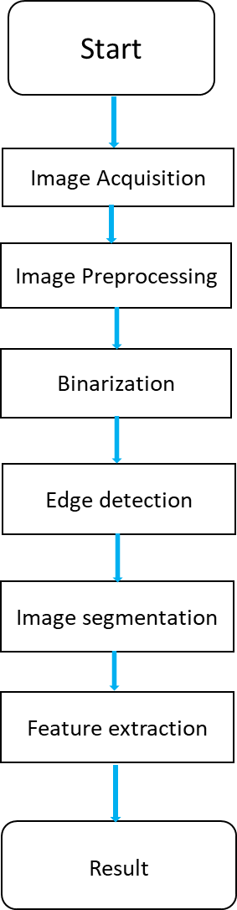
Flow chart of the project
Fig1. Flowchart of the project

Slide 8
Start: This is the starting point of the flowchart, indicating the initiation of the currency note recognition process.
Image Acquisition: In this step, an image of the currency note is acquired. This image could be obtained from a camera or loaded from a file.
Image Preprocessing: The image undergoes preprocessing techniques to improve its quality and suitability for further analysis, including resizing, removing noise, and adjusting brightness and contrast.
Binarization: Binarization converts preprocessed images into binary format, representing each pixel as black or white, simplifying subsequent processing by reducing the image to a binary format.

Slide 9
Image Segmentation:The image is segmented into distinct regions based on the detected edges, enabling isolation and analysis of specific currency note components.
Feature Extraction: The process involves extracting essential features like shape, texture, and intensity from the segmented regions of the image to differentiate between different currency note characters or elements.
Result: After extracting features from the image, the recognized information is written to an output file or database for further analysis.

Slide 10
Components Required
Simulink:
• Signal Acquisition: Simulink can interface with hardware to capture audio or image signals of a note.
• Preprocessing: Filtering and noise reduction blocks clean the captured signal for further processing.
• Feature Extraction: Fast Fourier Transform (FFT) blocks extract relevant features from the signal.
• Classification: Machine learning algorithms like SVM or Neural Networks are trained on a dataset of known genuine and counterfeit notes.
• Output and Decision Making: Classification results can be displayed visually or sent to external hardware. Additional logic blocks can trigger further actions based on classification.

Slide 11
Algorithm of the project
1. Input Acquisition:
Capture or load the currency note image.
2. Preprocessing:
Convert the image to grayscale.
Resize the image to reduce processing time.
Apply Gaussian blur to remove noise from image.
3. Binarization:
Apply adaptive thresholding to create a binary image

Slide 12
4. Image Segmentation:
Find contours in the binary image.
Filter out small contours to remove noise.
Extract bounding boxes around remaining contours.
5. Feature Extraction:
For each segmented region:
Height, width, aspect ratio, and bounding box dimensions of each character
Extract texture features ( local binary patterns).
Compute intensity-based features (mean intensity, standard deviation).
7. Output:
Display recognized denomination or characters.

Slide 13
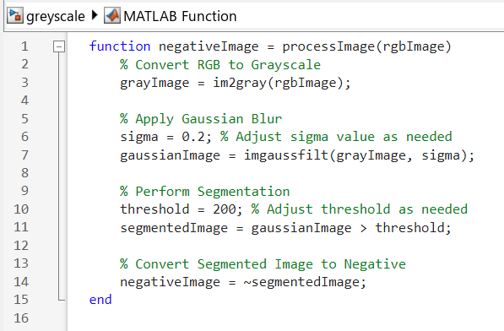
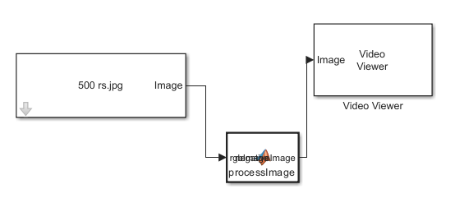
Simulink Implementation
Fig 3. MATLAB Function code
Fig 4. Simulink implementation

Slide 14
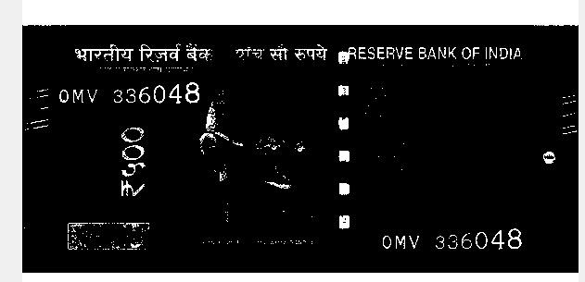
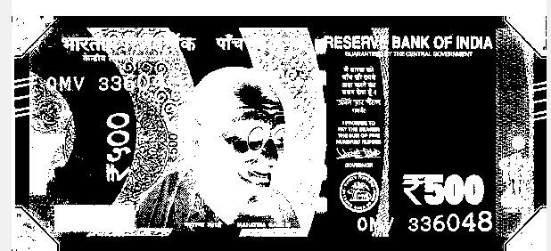
Pre processed image
Fig 5. Segmentation of a currency note
Fig 6. Image after applying threshold

Slide 15
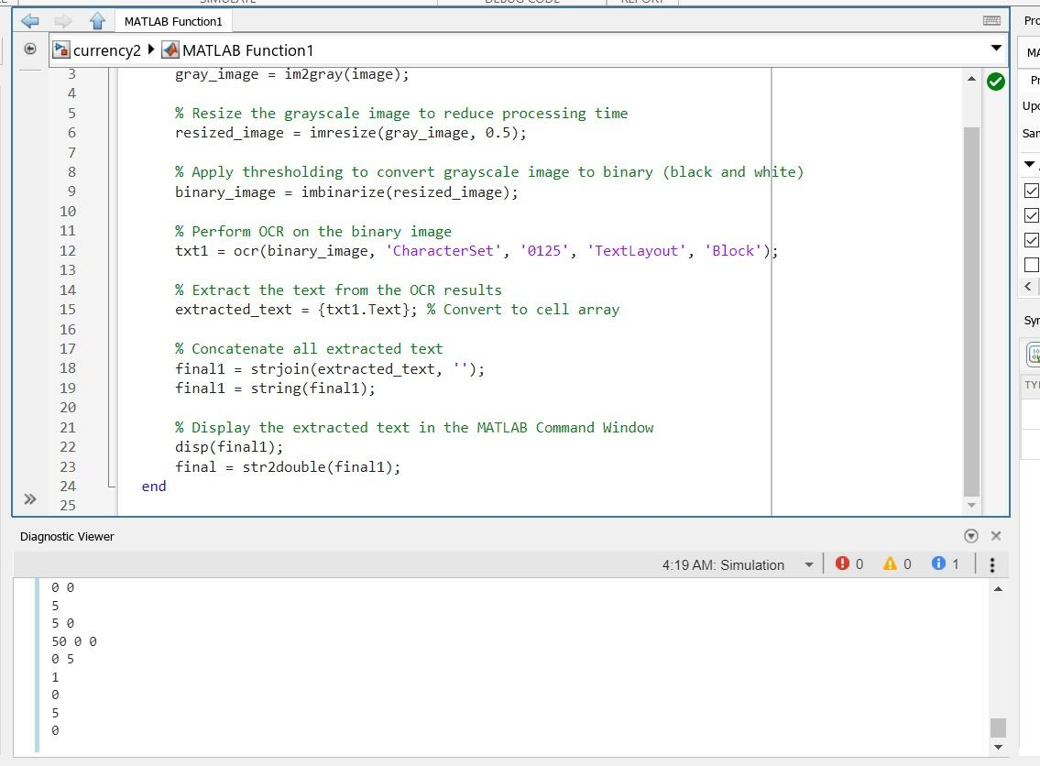
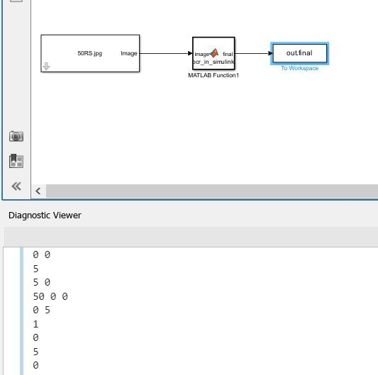
Implementation of the Project

Slide 16
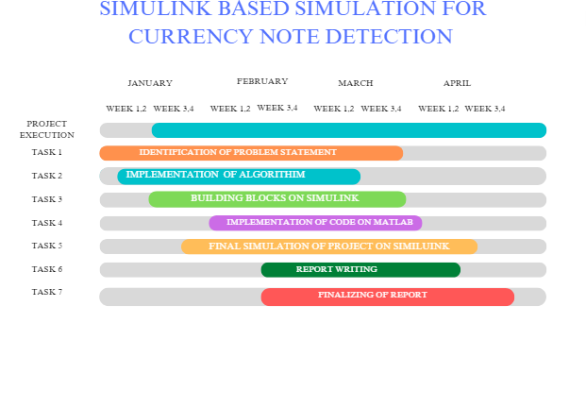
Time Chart

Slide 17
Conclusion
The goal of the project is to create a complete system that can accurately identify characters on banknotes to recognise denomination of the currency.
It streamlines currency handling processes, reducing manual errors and increasing operational efficiency in cash-centric environments
This process involves a series of steps, including preprocessing, text localization, character segmentation, feature extraction, and classification, culminating in the accurate identification of currency denominations.

Slide 18
References
G Chinmay Bhurke, Meghana Sirdeshmukh, Prof. Mrs. M.S.Kanitkar “Currency Recognition Using Image Processing s,” International Journal of Innovative Research in Computer and Communication Engineering, vol.III,May 2015.
H. Hassanpour, A.Yaseri, G.Ardeshiri,"Feature Extraction for Paper currency Recognition", 2007 IEEE 9th international Symposium on signal processing and its Applications, doi:10.1109/isspa.2007.4555366.
Rushikesh Jadhav, Swaraj Kalbande, Rohan Katkar, Rohan Katta, Prof. Rakhi Bharadwaj “Currency Recognition using Machine Learning”, International Research Journal of Engineering and Technology, vol.IX, January 2022.
Ingulkar Ashwini Suresh, Prof.P.P.Narwade “Indian Currency Recognition and Verification Using Image Processing”, International Research Journal of Engineering and Technology, vol.III, June 2016.

Slide 19
Thank you

